Slide 1
Insert
Project by:
Andrew Letailleur
Kirstin Jackson

Slide 2
Meet the team
Andrew Letailleur
-
Head Programmer
Level Designer
Kirstin Jackson
-
Head Artist
Documenter
Tester

Slide 3
What we have learned
Andrew:
Properly working with Lighting Effects
More advanced AI that chases player
Making a working game on a shorter timeframe, and when to cut features
The value of jolly co-operation within a team.
On the merits of change, when it comes to task management.
Kirstin:
The patience of relearning how to make pixels within the Gimp program
Working within a 2 person team
Being able to openly express ideas and hear feedback concerning the ideas for the game as well as provide my own feedback when needed
Having to cut plans for the game short due to limited time frames to meet the expected deadline.

Slide 4
About the game
The main concept:
The game centers around a famous local legend in a small town where the Prince of this town committed a great sin against a local witch whom in revenge, not only cursed the said Prince but the local residents and all guests into an eternal purgatory.
Due to this legend, the Mansion remained abandoned and fell into a state of disrepair. This leads to the local children challenging their friends to remain one night within the haunted boundaries of the Mansion.
Enter the protagonist, dared to spend a night within the halls of the Mansion. Believing the legend is nothing more than a fairy tale, he enters.
During the course of the night, the protagonist wakes to find himself trapped within the bowels of an eternal Hell, finding that his only escape is to locate the key that unlocks the door.
The protagonist has till sunrise to find the key and escape the Mansion or he will be the latest victim to the curse.

Slide 5



Engines that were used
For the coding and general building:
For the assets:
For audio:

Slide 6
2D vs 3D
After much discussion, we choose as a group to do the game in a 2D style over a 3D style for a few reasons:
* For a horror, puzzle style game – 2D just adds more into the atmosphere, creating a more creepy look and feel to the game compared to 3D.
* Let's be honest, how many 3D horror games are available on the market? Besides Resident Evil 7 which the 3D elements made it feel more cheesy than terrifying.
* Easier to source for 2D, most graphics could be made using a simple art program, where for 3D, finding models that would fit our needs would be more time consuming and stressful than required.

Slide 7
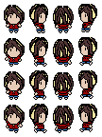
The Main Protagonist
Name: Ryley
Age: Preteen (10 - 11)
Gender: Male
Ryley just wishes to prove to his friends that he has the guts to remain in the 'Haunted' Mansion overnight. This might be his downfall, since after a certain time at night, the Mansion's curse reawakens and anyone caught inside can end up being the next victim.
Appearance

Slide 8
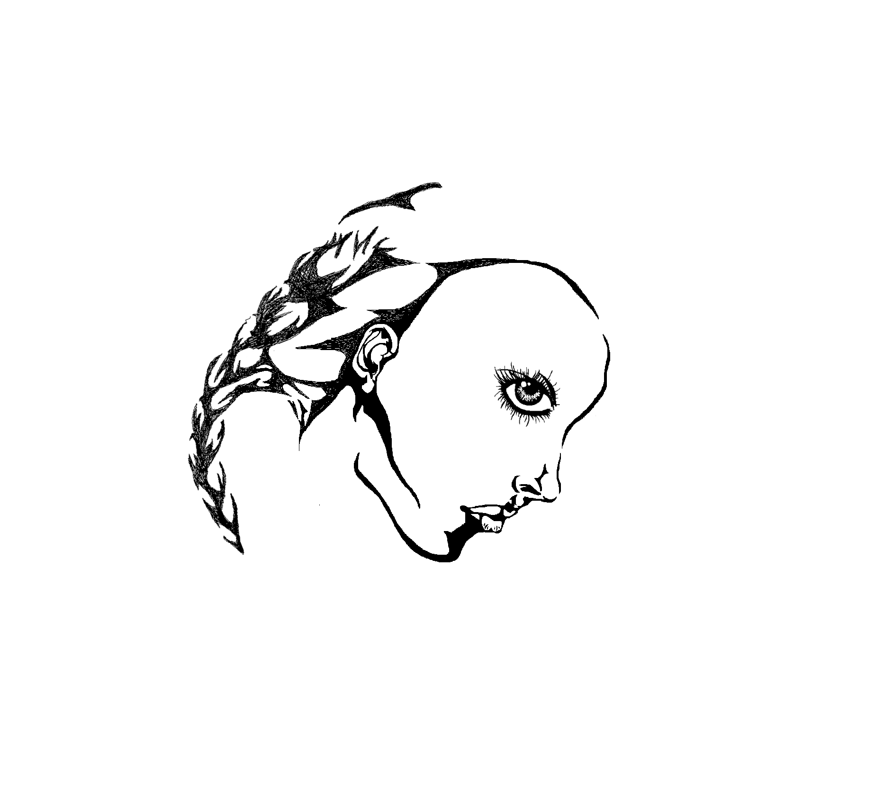
Concept Art of the Protagonist
* At the start, the main idea was to have a character that could pass as female or male. The name Ryley was chosen since it is a name that can be giving to both a male and a female.
* In the end, the spirits that were made, show the Protagonist as a male, since most preteen girls would be more interested in make up and boys where boys would be more likely to challenge each other to these sort of dares.

Slide 9

Enemies
The Basic Enemy:
The Main Enemy:
*Boss hasn’t been included, due to time constraints of the demo. But is envisioned to be “The Beast”, and the cursed prince, targeted by the curse.
He will not fade away when he catches the player, and can be very dangerous if left unchecked.

Slide 10


Concept Art for the Enemies
* The type of enemies we discussed having ranged from will-o-wisps to kitsunes to the Grim Reaper himself. (Who would have been a possible ‘boss’ encounter.)
* These were the first prototypes of the ghost.
* References during the prototype stage would include: the Boos from Super Marios Brothers and Haunter from Pokemon.

Slide 11
The Environment
Mansion
  Dark, and with limited light. Consists of stone walls, and dark flooring.
  Consists of two floors; the ground floor, where the exit is, and the first floor, where the key is placed.
  The exit requires a key in order to exit the cursed mansion.
Courtyard
  More Green like in appearance, yet just as dark due to accursed night-time.
  Maze Like, that is hard to navigate to the exit, as much as leave less room to avoid collision with ghosts.
  The Beast would reside here, endlessly chasing the player in sprints, and can only be avoided, not killed by collision.

Slide 12
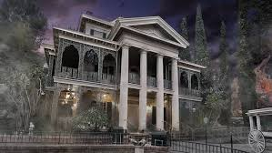
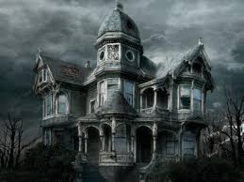
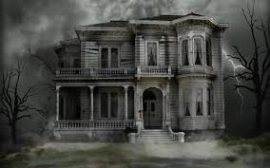
Concept Art for the Environment
* Since there was no time period when the Mansion was built, the Mansion would be similar in style of 'Victorian' or like the famous Haunted Mansion in Walt Disney World, Florida.
* Since no one kept proper maintenance over the years, parts of the Mansion which could include full rooms, would be inaccessible to the player. This could be from a number of reasons such as sections of the Mansion's roof being damaged or have rotted away, thus leaving rooms open to sustaining damage from leaks or just being exposed to the elements for number of years. This would lead to areas where the floor may be too unstable to walk upon or has simply rotted away causing the floors to either be close to collapsing or already collapsed onto the lower level below – which will make the room below too dangerous for the player to access as well.

Slide 13
Music Style
* The music style we choose to go with is a mix of 'horror', 'Gothic' and 'new age' style.
* The music will add ambiance to the game as the player explores the mansion.
Credit to the music tracks used:
Darren Curtis
@ DesperateMeasurez on youtube
www.darrencurtismusic.com

Slide 14
The Demo
*INSERT VIDEO TRAILER*

Slide 15
Credit where Credit is due..
* Reference Photos:
Disney (2017). Haunted Mansion. [image] Available at: https://disneyland.disney.go.com/attractions/disneyland/haunted-mansion/ [Accessed 24 Oct. 2017].
ScaryforKids (2015). Disney Haunted Mansion. [image] Available at: http://www.scaryforkids.com/haunted-mansions/ [Accessed 24 Oct. 2017]
LovesthisPic. Haunted Mansion. [image] Available at: http://www.lovethispic.com/image/40534/haunted-mansion/ [Accessed 24 Oct. 2017]

